Slide 1
Geophysical exploration for gold and associated minerals IN Wadi El Beida area, Southeastern Desert, Egypt

Slide 2
Team members
RHITAM NAYEK
SHASANK SINGH
NAINI KARTHIK

Slide 3
REASON OF CHOOSING /about
The occurrences of gold and disseminated sulfides lie as a part of the shearing fault zone that extends from the north to the south of the study area for a length of about 25 km. The gold located on the alteration shear zone which is composed of quartz–feldspathic highly ferruginated rock (gossans) occupying the eastern and central parts of the area. The main reason of choosing this area is that there are two anomalous spots of gold contents; the first one has values ranging from 5 to 49 g ton–1 and the second anomaly has values ranging from 150 to 502.5 g ton–1 and the different featueres of thse parts make it an exceptional zone to be studied about.

Slide 4
objective
To understand the geology of Wadi El Beida area, Southeastern Desert, Egypt.
To use various methods to accumulate self potential data of this particular region.
To represent the data collected in a graphical form and to understand the variations in graph.

Slide 5
geology
Here the surface geology of the area includes basic to intermediate metavolcanic andesite rocks and alteration shear zones. The metavolcanics are located at the eastern and western parts of the study area which is characterized by dark grey colour and contains disseminated sulfides. The basic volcanic rocks are located at the northern and southern parts of the area where these are characterized by greenish grey colour and mineralized at the northeastern and southwestern parts of the area.

Slide 6
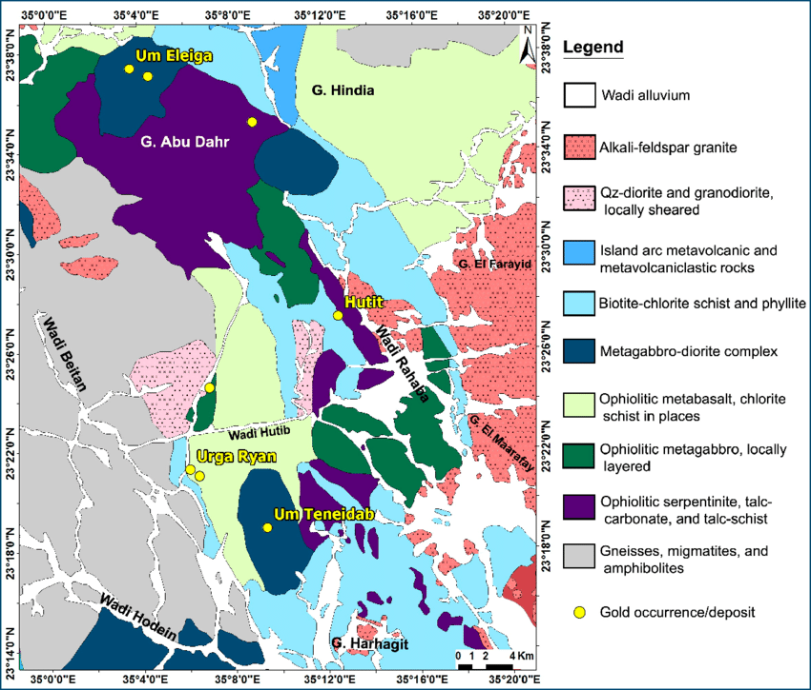
Alteration shear zones include three types; the first one is mainly composed of quartz–feldspathic highly ferruginated rock (gossans) occupying the eastern and central parts of the area. The second is represented by light grey colour with some pyrite and iron oxides. The third one is a barren alteration zone which is distributed throughout the entire area and exhibits a light grey colour with no mineralization.

Slide 7
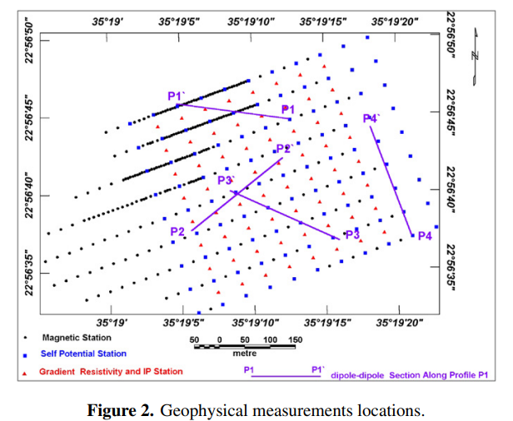
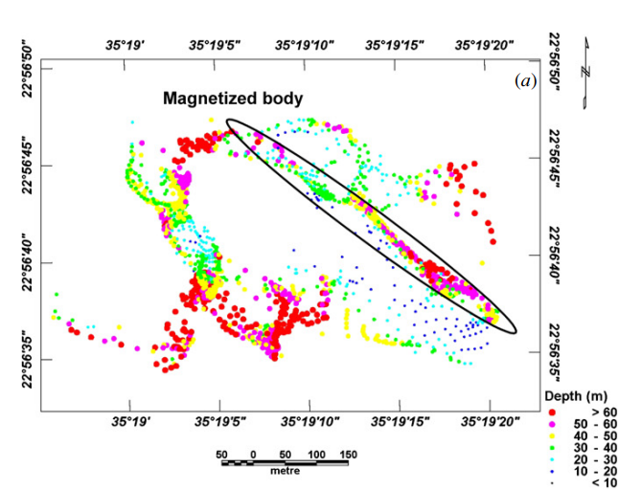
Data acquisition
By SP method-
Here, the self-potential measurements were carried out on a grid of 50 × 50 m2 for an area of about 500 × 400 m2 using a Syscal-R2 instrument using manual mode. The measurements were carried out through the first day of April 2007. Non-polarized electrodes of copper sulfate were used; an electrode was positioned at infinity (a distance of about 500 m from the centre of the area) and the second one was used for field measurements of natural self-potential in millivolts. The resulting SP anomaly map indicates that weak SP negative anomalies lie above the high shearing alteration zone, trending in the NW–SE direction. Trial-and-error interpretation of SP anomalies Four SP profiles (SP1 through SP4) were modelled using the forward program presented by Caglar

Slide 8
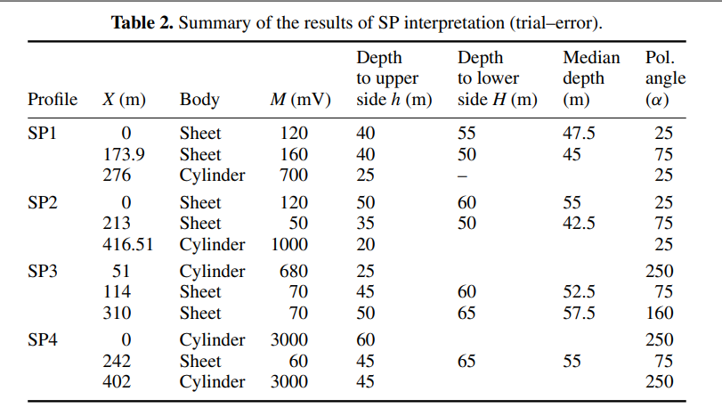
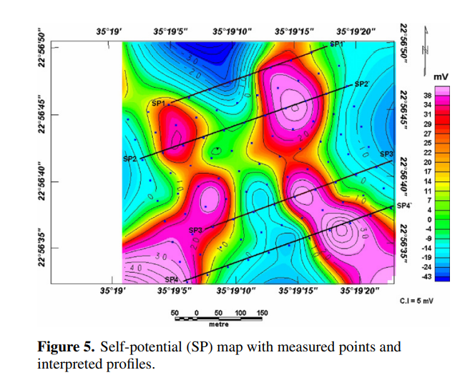
Data interpretation and representation with contour lines

Slide 9
Data acquisition (other method)
2) Inversion of SP data using the PSO method
To understand let us Suppose a group of birds is searching for food in an area. One of the best strategies to find the food is to follow the bird that is nearest to the food. The undetermined geophysical models are analogous to the birds (called particles in the PSO method) ‘flying’ in the search space and the objective function of the inverse problem is analogous to the distance between ‘bird’ and ‘food. ’. Each particle has an objective function value and has a ‘velocity’ which controls the ‘flying’ in the search.

Slide 10
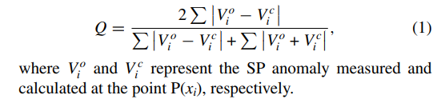
DATA INTERPRETATION
. In this work the objective function Q was defined as
The velocity of a particle depends on its current position, on its best position and on the best position that was achieved by the group of particles in the search space. PSO starts with a group of random models (particles). In every iteration, each model is updated taking into account two best models: the first one is the best model achieved so far by the particle and the second one is the best model obtained by any particle of the group . The update is made using the following equations:

Slide 11
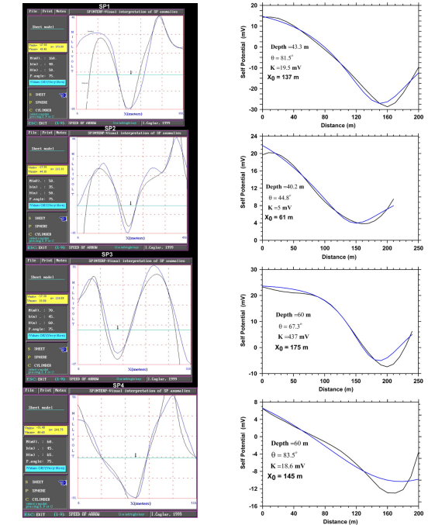
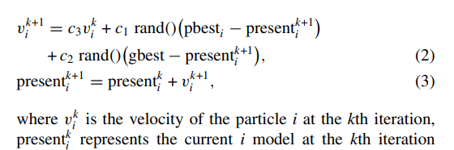
rand() is a random number between 0 and 1. spacec1, c2 represent learning factors controlling the individual and the social behaviour, respectively. c3 is an inertial coefficient whose value is usually slightly less than 1. All solutions presented in this work have been calculated with c1 = 2.0, c2 = 2.0 and c3 = 0.9. It was verified that the number of iterations, to reach a good fit, depends on the problem and ranges from 100 to 300 in the examples included in this work. The data observed are represented in the form of graph.

Slide 12
discussion
The geological map shown in exhibits alteration zones and fault elements of NW–SE trend. These faults are clearly displayed in the first vertical derivative of the magnetic map . Also the interpretation of the geophysical data indicates that these trends might be associated with alteration zones and have been tentatively interpreted as related to ore deposits at different depths. The comparison between the results of Euler deconvolution and magnetic models reveals a good compatibility between the results concerning depths and locations of the magnetized bodies. For example, the depth of the ore body in profile M2 is estimated to be 50 m from Euler solutions and 45 m from magnetic models. The depth of the body in profile 8 ranges from 40 to 50 m from Euler solutions and 45 m from the magnetic model.

Slide 13
. Integrated interpretation map for the geological and geophysical results. method. The results are also well matched, for example the results of depth and polarization angle for profile SP1 are 43.3 m and 81.5◦ from the, while these parameters were estimated as being 40 m and 75◦ using the. The gradient resistivity map and IP-chargeability map reflect the same trend of low resistivity and high chargeability. The depth of the ore body from the gradient resistivity profiles indicates a depth ranging from 21.2 to 62.3 m and maximum width ranging from 52.6 to 165.2 m. The low resistivity and high chargeability for the last part of the dipole–dipole section ‘P1’ are well suited with the gradient resistivity and IP maps. The mid part of the dipole– dipole section from profile ‘P2’ reveals low resistivity and high chargeability at depths in the range of 35–60 m which is closely matched with the gradient results. The results of mineralogical analyses from two field samples have indicated that the ore bodies, which have been detected from geophysical interpretation, are rich with gold content of 5–502.5 g ton–1.

Slide 14
conclusion
Gold and disseminated sulfides are located on an alteration shear zone which is composed of quartz–feldspathic highly ferruginated rock (gossans) occupying the eastern and central parts of the area.
The results of the magnetic interpretation indicated that the depths of such ore deposits range from 35.9 to 52.7 m and the half width ranges from 27.2 to 87.8 m
The results of self-potential (SP) data indicated that the depths of the ore bodies range from 20 to 60 m.
(6) The results presented in this study indicate that these high gold grades are associated with a shallow linear feature that is identified by a number of geophysical technique (figure 15). The exact form of any potential ore body will have to be confirmed by a borehole drilling program.

Slide 15
references
Anderson L A 1984 Self-potential investigations in the Puhimau thermal area, Kilauea Volcano, Hawaii SEG Expanded Abstr. 3 84 DOI:10.1190/1.1894270
Atchuta Rao D and Ram Babu H V 1983 Quantitative interpretation of self-potential anomalies due to two-dimensional sheet-like bodies Geophysics 48 1659–64
Bhattacharyya B B and Roy N 1981 A note on the use of a monogram for self-potential anomalies Geophys. Prospect. 29 102–7
Caglar I 2000 Short Note Visual interpretation of superposed self-potential anomalies in mineral exploration Comput. Geosci. 26 847–52
Corry C E 1981 The role of the self-potential method in the exploration for molybdenite AMAX, Climax Molybdenum Co., Golden, CO, 53 pp (7 maps)

Slide 16
Thank you

